Slide 1

Things you can learn from the C++ standard library
and how to use them

Slide 2

TOPICS
Being AIV an academy and me a teacher for the student of the first year, this talk will get you through what you can get done with few simple bricks of knowledge taken directly from the algorithms and data structures of the C++ standard library.
We all know that it’s rude not to greet a newcomer with a “Hello World”, but do you remember what was your very first assignment after that?
Swap
More swap
Clever things you can do with swap
Even more clever things you can do with swap
Heap Swap

Slide 3
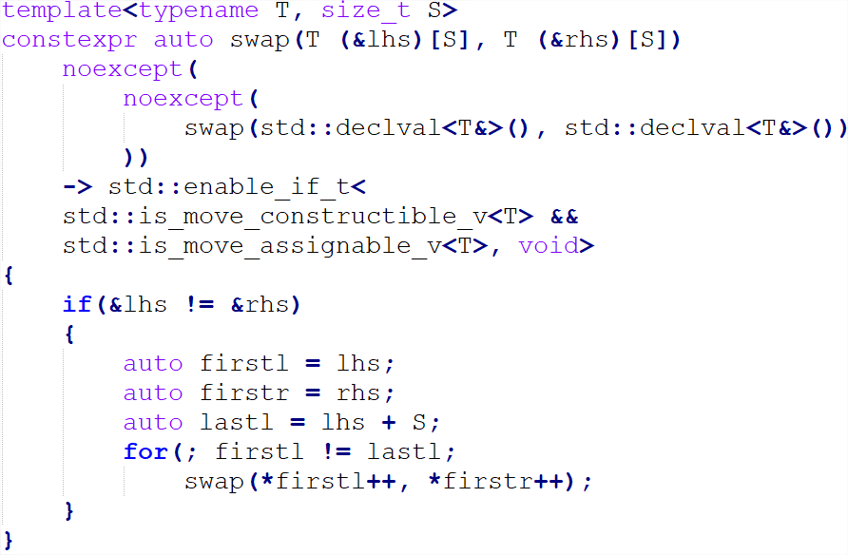
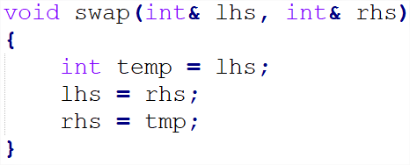
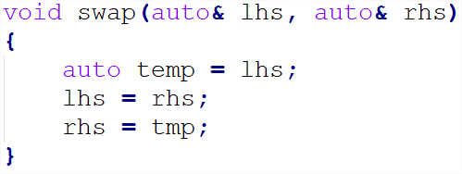
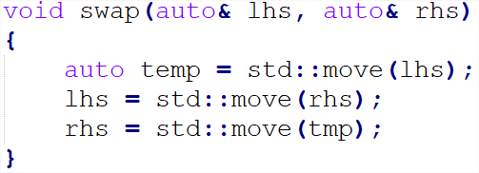
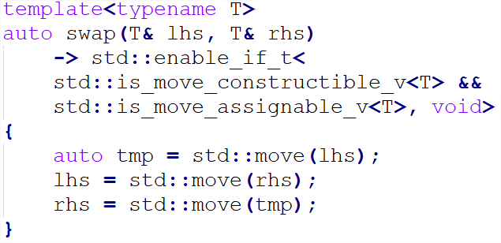
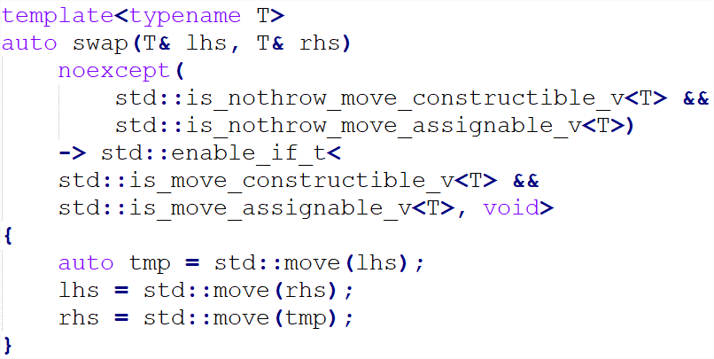
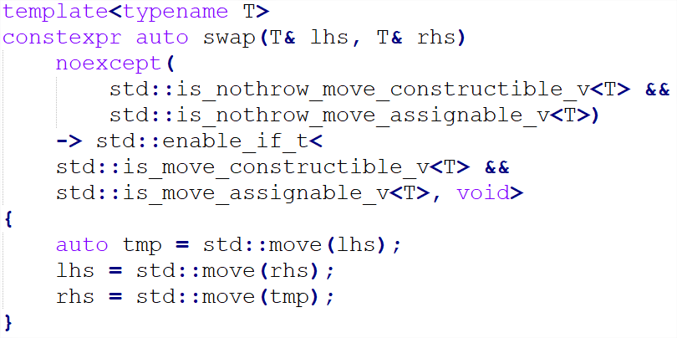
SWAP !

Slide 4
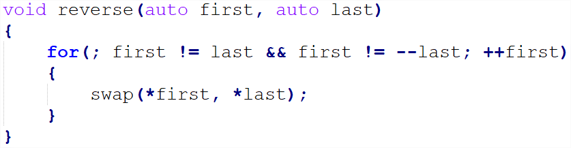
SWAP MORE, REVERSE !
The very first and most practical use of swap can be found at page 2 of the exercise book, right before asking Otis to sit on a potato pan.

Slide 5
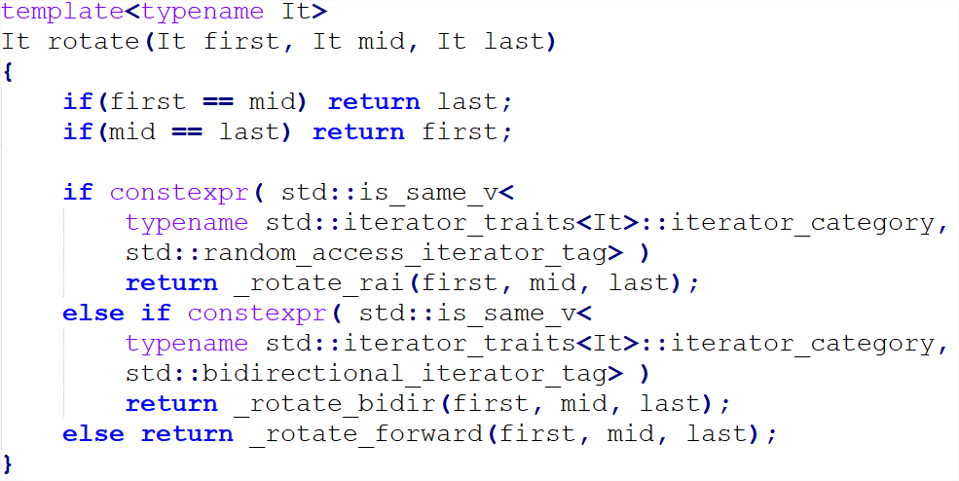
CLEVER SWAPS, ROTATE !
To rotate may seems a trivial affair, but to implement is not an easy task.

Slide 6
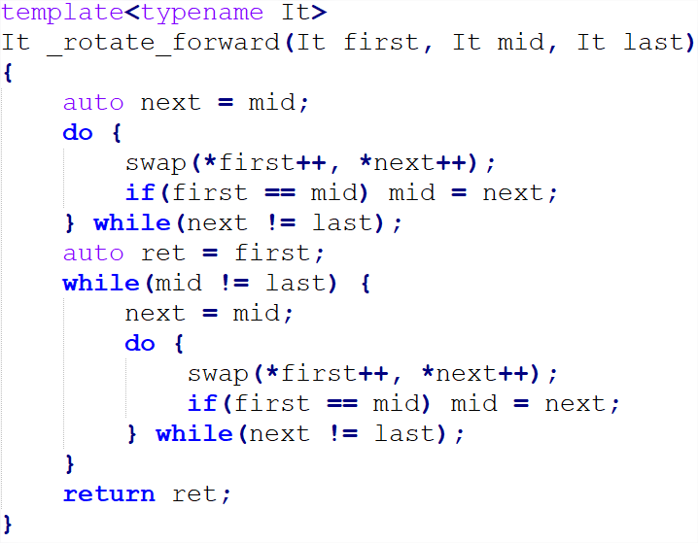
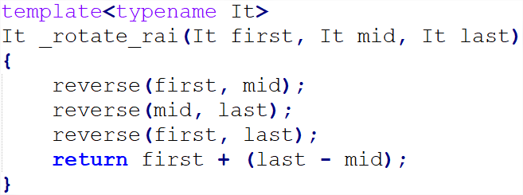
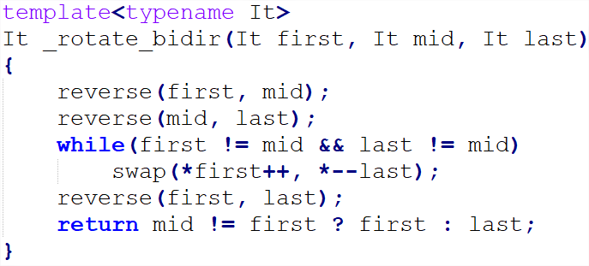
CLEVER SWAPS, ROTATE !

Slide 7
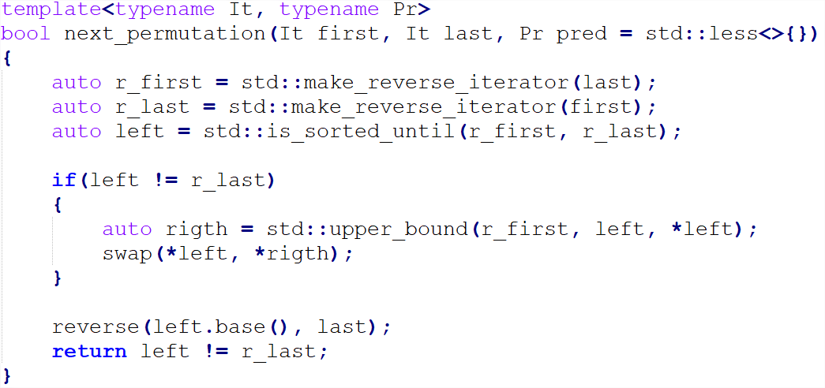
EVEN MORE CLEVER SWAPS

Slide 8
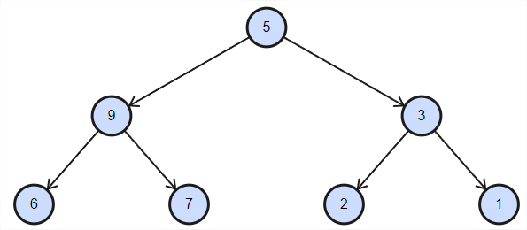

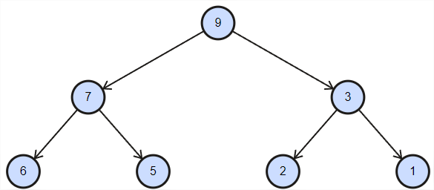

(BINARY) HEAP

Slide 9
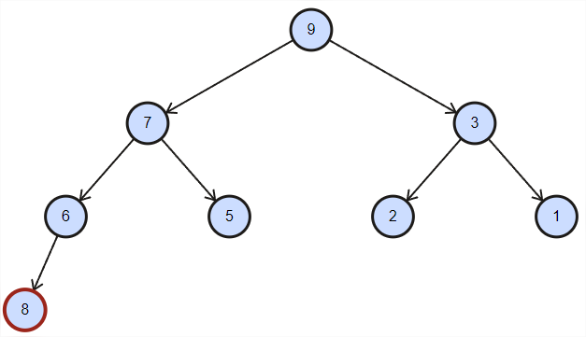

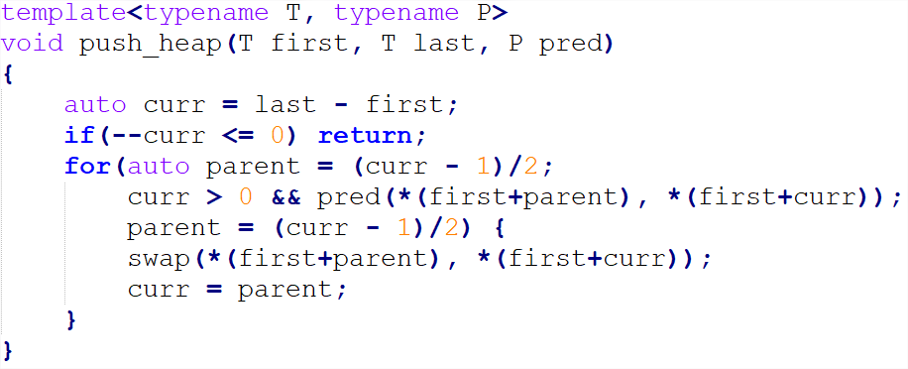
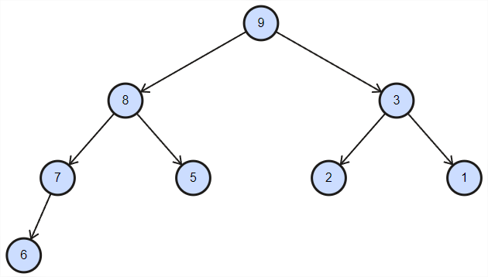
BINARY HEAP, WITH SWAP

Slide 10
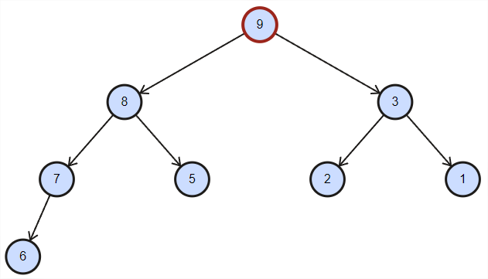
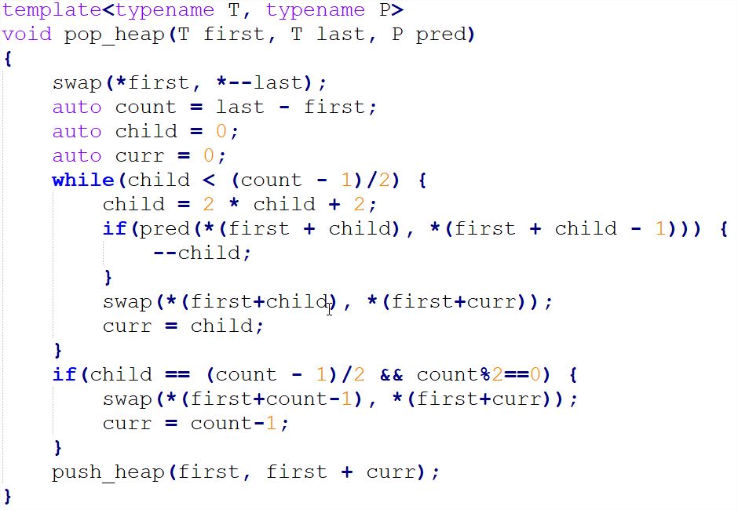
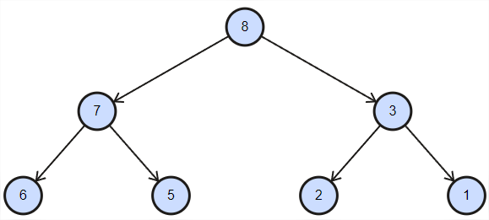
BINARY HEAP, WITH SWAP

Slide 11
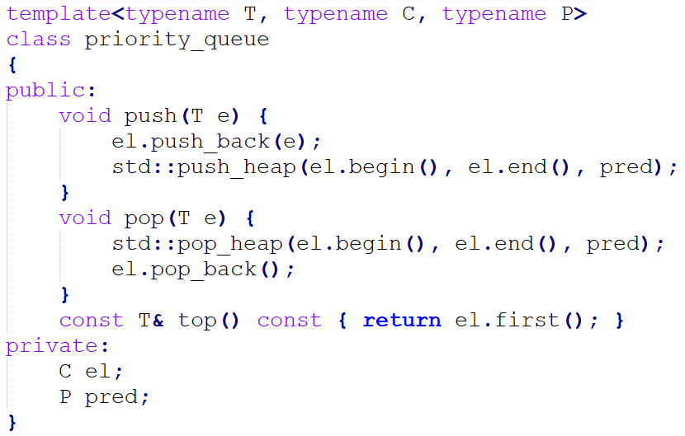
PRIORITY_QUEUE

Slide 12
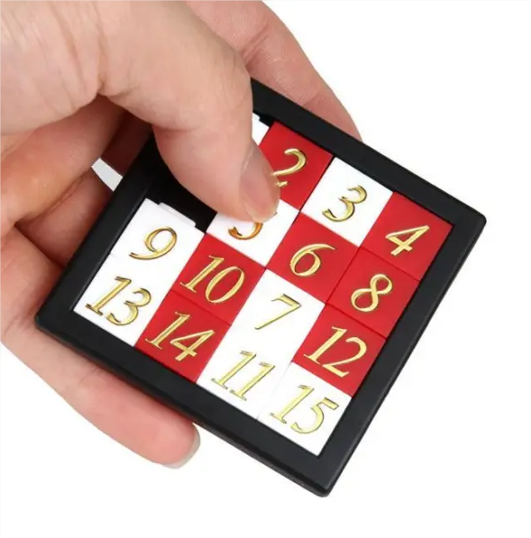
The Game of 15
4x4 Grid
15 Tiles and one hole
Sort the tiles from 1 to 15

Slide 13
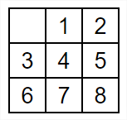
The Game of 8
3x3 Grid
9 Tiles and one hole
Sort the tiles from 1 to 8

Slide 14
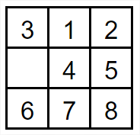
The Game of 8
Moving the hole horizontally doesn’t change the sequence
Moving the hole down rotates the 3 next elements of the sequence by 1 on the right
Moving the hole up rotates the 3 previous elements of the sequence by 1 on the left

Slide 15
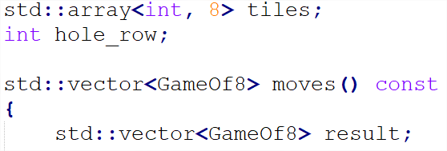
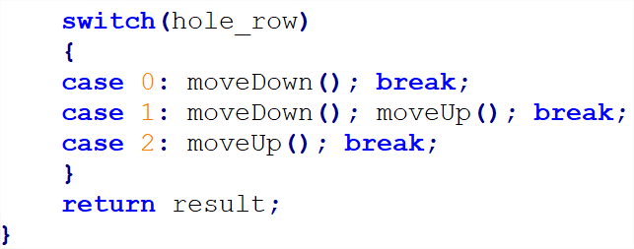
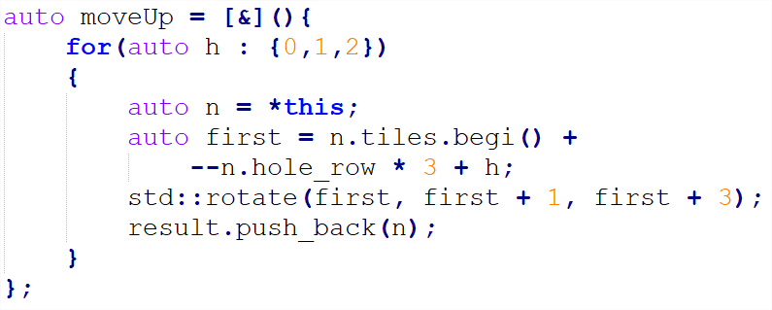
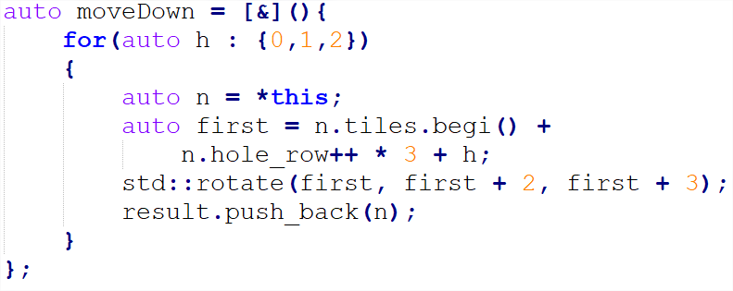
Game of 8
We represent the game of 8 as an array of 8 numbers (tiles) plus a number (hole_row), from 0 to 2, which represent the row of the hole.

Slide 16
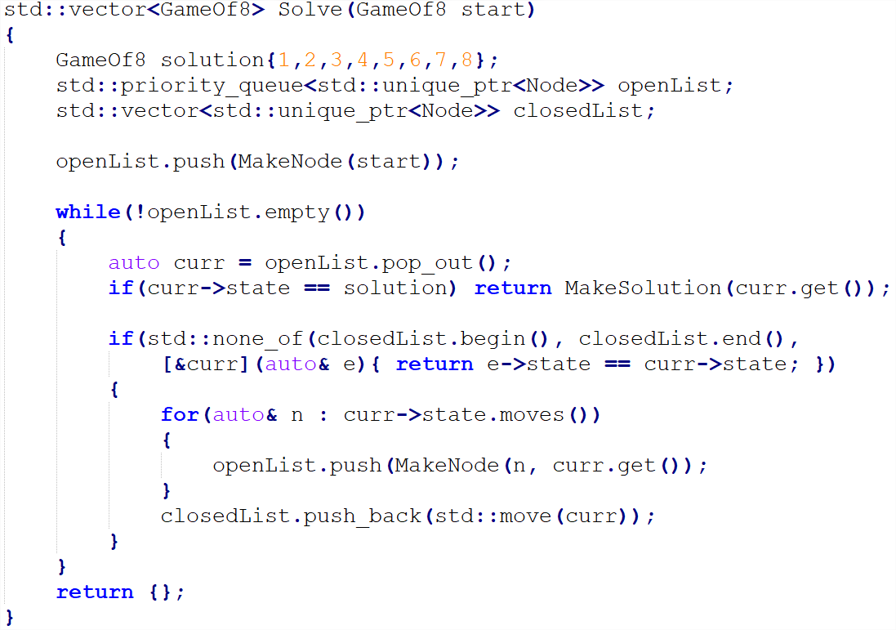
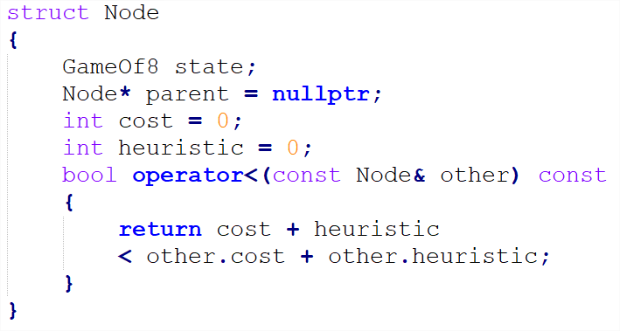
Solving the Game of 8, A*
A* is a graph search algorithm that uses a priority queue to visit the states that are most likely to be close to the solution first.

Slide 17
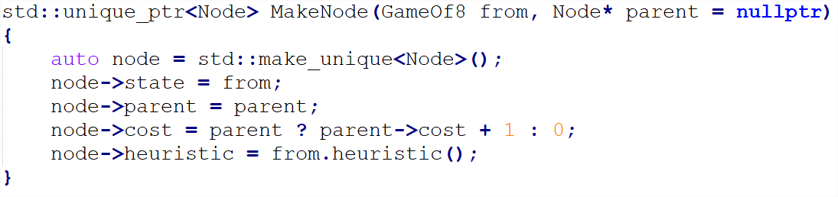
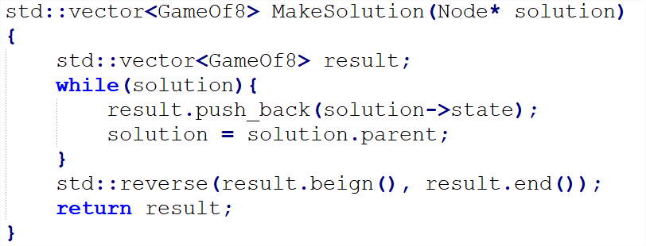
Solving the Game of 8, A*

Slide 18
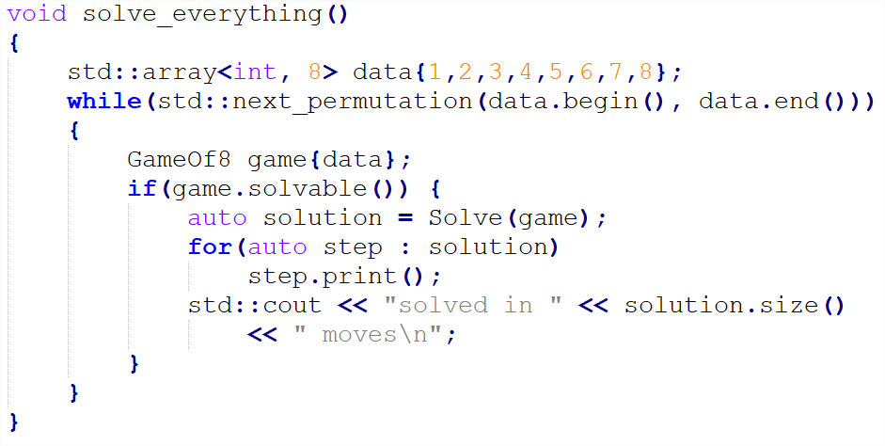
Solving every possible Game of 8

Slide 19
DEMO TIME !

Slide 20

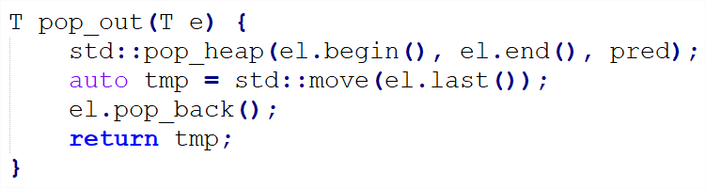

EXTRA
https://groups.google.com/a/isocpp.org/g/std-proposals/c/AQ2bJxtT_4g/m/Z2yffXaudkcJ

Slide 21
THANKS

Slide 22
QUESTIONS ?

